Slide 1
Python Concepts
October 8, 2019

Slide 2
Course Overview
Journal Entries are important.
Use the journal for extra notes each day.
GitHub (do you have an account)?

Slide 3
Lesson 1.9
This lesson examines the differences between analog and digital systems.
Students will be able to describe analog data, digital data, and data compression.

Slide 4
What is the computer doing when it accepts input?
Humans receive analog information, the sights and sounds of the things around us are analog.
A computer can’t process information the same way we do. It requires information to be in a digital format.
All of the data a computer receives is converted into a number before it can be processed. A computer only reads zeros and ones… really, really fast.

Slide 5
Analog Information
Journal Time!!
Relating to or using signals or information represented by a continuously variable physical quantity such as spatial position or voltages.
Data from the real world

Slide 6
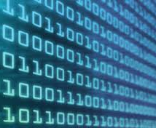
Digital data
Analog data is converted into numeric data to be stored in a computing device.
These numbers are transmitted and stored using electronic signals.

Slide 7
Input
Computer input devices
Microphones
Scanners
Convert analog information to digital data that can be stored.
Pros and Cons
Advantages—data compression lets you store huge amounts of data
Cons—quality is lost.

Slide 8
Summary
Computers store information in 1s and 0s and this is because computers use digital components.
Something is defined as digital when it has an off or on state, with nothing in between.

Slide 9
1.10 Bits and Pieces— Understanding Binary
Objectives
Describe and define computer memory and binary code.
Convert a number form decimal to binary representation.

Slide 10
Introduction
Lesson 10: Bits and Pieces Video
You store programming information in your paper-based journal. But, how does a computer store information.
Computer Memory
Stores data and information in binary.
Vocabulary
Binary—A number based on two.
Decimal—A number system based on ten, the number system we normally use.

Slide 11
Inside the computer
Information is stored in binary
1s and 0s
Used to code
It’s the foundation

Slide 12
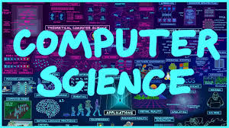
1.11 Career Connection
Who uses Computer Science?
How does computer science used in almost every industry across the globe?

